Slide 1
LADY WINE GEEKS
PROJECT 3 - GROUP 1
ERICKA HOULE, ALISHA HILL, DIANA MELENDEZ
OCTOBER 2021

Slide 2

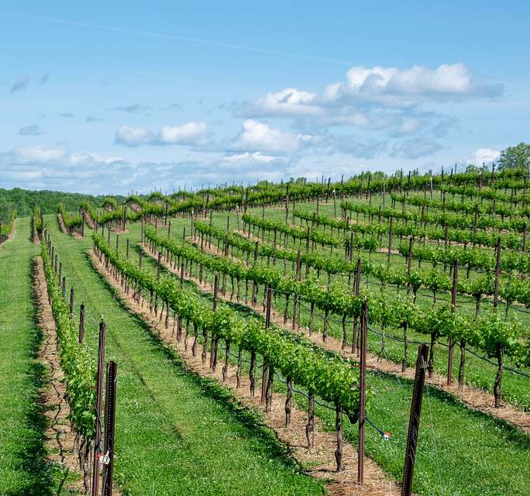
INSPIRATION & REASONING
NAPA VALLEY / EUROPEAN STYLE STAYCATION.
Notes:
Our inspiration came from the idea of bringing the taste of wine country into your own home. Can we have the quality and taste without the cost of traveling?
In these times of quarantine and staycations, we are looking for our data to bring an informed decision when looking for a wine based on type and rating of points.
Our Dataset is based on reviews of wines from the year 2017. Our data reflects country, province, winery, type, variety and points by review from the Wine Enthusiast Magazine.

Slide 3
DESIGN CHOICES
Streamlined Minimalism
Vertical Navigation Bar
Interactive Visualizations
Wine Color Scheme
Notes:
Our design influence is based on a streamlined look with a nod to the elegance and quality of our variety of wines from California to Europe.
Our dashboard includes a vertical navigation bar on the left side of the screen to toggle between the different pages which include our overview, “about us” page, visualizations, and works cited. The color scheme is a reference to the red wine type and image referenced on the dashboard that are wine related.

Slide 4
HYPOTHESES
What wine type is the most popular ? Red or White wine?
Which is the region with highest production and the highest points by review?
What provinces have the highest points based on the reviews?
Notes:
We hypothesize that our data will show that the most popular type is White Wine.
We are looking to answer the following questions:
What type (Red or White) is the most popular?
Which country and province has the highest density of production?
What varieties are popular in what provinces by country?
What variety has the highest points for each type (red or white wine)?
***** for reference only (Our data reflects country, province, winery, type, variety and points by review from the Wine Enthusiast Magazine.

Slide 5
LIVE DEMO
Lady Wine Geek's Website
Notes:
Plotly Visualizations (1) & Data Table
3rd Vis will be the packed bubble chart by type and province and the 4th is the Map showing density and markers by country and province.
5th Vis will be the Sunburst showing breakdown of type and variety.

Slide 6

CONCLUSIONS
Highest production in California.
Most popular type is Red Wine.
Most popular variety in the White category is Chardonnay.
Most popular variety in the Red category is Shiraz (Syrah).
Notes:
Highest production of wine is in California.
The largest production of white wine variety is Chardonnay followed by Champagne Blend and Bordeaux-Style White Blend.
The Red Wine type has the highest production of Syrah(Shiraz), followed by Merlot and Cabernet Sauvignon.

Slide 7
LIMITATIONS & FUTURE WORK
Limitations -
Data limited to the year 2017 and our focus being on the top 100 wines based on points from reviews.
Our visualizations required the data to be in a variety of different formats specific to the individual charts.
Future Work -
To examine popularity of varieties in California due to the state’s high production of wine.
Examine popularity of Organic Wines in California.
Notes:
Limitations - Data limited to the year 2017 and our focus being on the top 100 wines based on points from reviews.
Future Work - 1. To examine popularity of wineries and varieties in California due to the state’s high production of wine.
2. Examine popularity of Organic Wines in California.

Slide 8

Q & A

Slide 9
WORKS CITED
Wine Reviews (Kaggle) - Main Data Set https://www.kaggle.com/zynicide/wine-reviews , https://www.kaggle.com/zynicide/wine-reviews?select=winemag-data_first150k.csv
GitHub Project- Referenced for wine varieties. https://github.com/06S197GT/SMU-Project-1
Packed Bubble Chart - Inspiration and code reference. https://www.highcharts.com/demo/packed-bubble-split
https://jsfiddle.net/gh/get/library/pure/highcharts/highcharts/tree/master/samples/highcharts/demo/packed-bubble-split
San Francisco Crime Class Activity - Starter code for Heat Layer May and Marker Map. https://smu.bootcampcontent.com/SMU-Coding-Bootcamp/smu-dal-data-pt-06-2021-u-c/-/tree/master/01-Lesson-Plans/15-Mapping-Web/2/Activities/02-Evr_CrimeHeatmap/Solved%20-%20Booth%20-%20Bootstrap
Sunburst Chart - Inspiration and code reference. - https://observablehq.com/@shuaihaofzny/sunburst-map-of-nyc-crime-data-in-2018

